Slide 1
Lecture 5
Memory Management
Tanenbaum, Modern Operating Systems 3 e, (c) 2008 Prentice-Hall, Inc. All rights reserved. 0-13-6006639

Slide 2
Virtual Memory
Swapping is too slow if the program is fully in memory (100 Mbytes/sec disk transfer rate=>10 sec to swap out a 1 Gbyte program)
Tanenbaum, Modern Operating Systems 3 e, (c) 2008 Prentice-Hall, Inc. All rights reserved. 0-13-6006639

Slide 3
Virtual Memory
Program’s address space is broken up into fixed size pages
Pages are mapped to physical memory but not all pages have to be in physical memory at the same time to run the program.
If instruction refers to a page in memory, fine
Otherwise OS gets the page, reads it in, and re-starts the instruction
While page is being read in, another process gets the CPU
Tanenbaum, Modern Operating Systems 3 e, (c) 2008 Prentice-Hall, Inc. All rights reserved. 0-13-6006639

Slide 4
Memory Management Unit
Program-generated addresses are called virtual addresses and form the virtual address space.
Memory Management Unit generates physical address from virtual address provided by the program
Tanenbaum, Modern Operating Systems 3 e, (c) 2008 Prentice-Hall, Inc. All rights reserved. 0-13-6006639

Slide 5

Memory Management Unit
MMU maps virtual addresses to physical addresses and puts them on memory bus
Tanenbaum, Modern Operating Systems 3 e, (c) 2008 Prentice-Hall, Inc. All rights reserved. 0-13-6006639

Slide 6
Pages and Page Frames
On any computer, programs reference a set of memory addresses.
These program-generated addresses are called virtual addresses and form the virtual address space.
When virtual memory is used, the virtual addresses do not go directly to the memory bus. Instead, they go to an MMU (Memory Management Unit) that maps the virtual addresses onto the physical memory addresses.
The virtual address space consists of fixed-size units called pages. The corresponding units in the physical memory are called page frames. The pages and page frames are generally the same size (range in size between 512 bytes - 64 KB)
Transfer between RAM and disk is in whole pages

Slide 7
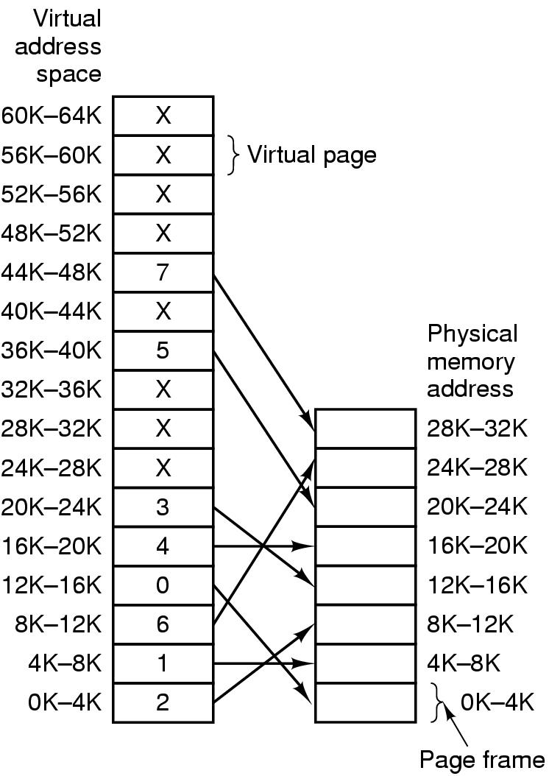
Mapping of pages to page frames
16 bit addresses, 4 KB pages
32 KB physical memory,
16 virtual pages and 8 page frames
Tanenbaum, Modern Operating Systems 3 e, (c) 2008 Prentice-Hall, Inc. All rights reserved. 0-13-6006639

Slide 8
Page Fault Processing
Present/absent bit tells whether page is in memory
What happens If address is not in memory?
Trap to the OS (This trap is called a page fault)
  OS picks page to write to disk
  Brings page with (needed) address into memory
  Re-starts instruction
Tanenbaum, Modern Operating Systems 3 e, (c) 2008 Prentice-Hall, Inc. All rights reserved. 0-13-6006639

Slide 9
Page Table
Virtual address={virtual page number, offset}
Virtual page number used to index into page table to find page frame number
If present/absent bit is set to 1, attach page frame number to the front of the offset, creating the physical address which is sent on the memory bus
Tanenbaum, Modern Operating Systems 3 e, (c) 2008 Prentice-Hall, Inc. All rights reserved. 0-13-6006639

Slide 10

MMU operation
Tanenbaum, Modern Operating Systems 3 e, (c) 2008 Prentice-Hall, Inc. All rights reserved. 0-13-6006639

Slide 11

Structure of Page Table Entry
Let us now turn to the exact layout of an entry in the page table.
Modified (dirty) bit: 1 means written to => have to write it to disk. 0 means don’t have to write to disk.
Referenced bit: 1 means it was either read or written. Used to pick page to evict. Don’t want to get rid of page which is being used.
Present (1) / Absent (0) bit
Protection bits: In the simplest form, this field contains 1 bit, with 0 for read/write and 1 for read only. A more sophisticated arrangement is having 3 bits, one bit each for enabling reading, writing, and executing the page.

Slide 12
Speeding up paging
Virtual to physical mapping is done on every memory reference => mapping must be fast
If the virtual address space is large, the page table will be large. 32 bit addresses now and 64 bits becoming more common
Tanenbaum, Modern Operating Systems 3 e, (c) 2008 Prentice-Hall, Inc. All rights reserved. 0-13-6006639

Slide 13
Speed up Address Translation
Most programs access a small number of pages a great deal
Add Translation Lookaside Buffer (TLB) to MMU
  A small hardware device for mapping virtual addresses to physical addresses without going through the page table.
  Stores frequently accessed frames
Tanenbaum, Modern Operating Systems 3 e, (c) 2008 Prentice-Hall, Inc. All rights reserved. 0-13-6006639

Slide 14
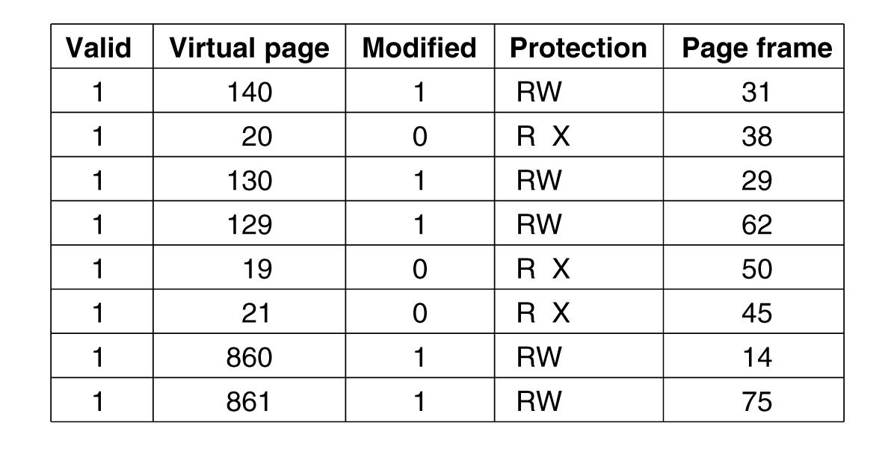
Translation Lookaside Buffers
Valid bit indicates whether page is in use or not
Tanenbaum, Modern Operating Systems 3 e, (c) 2008 Prentice-Hall, Inc. All rights reserved. 0-13-6006639

Slide 15
Translation Lookaside Buffer(TLB)
When a virtual address is presented to the MMU for translation, the hardware first checks to see if its virtual page number is present in the TLB by comparing it to all the entries simultaneously (i.e., in parallel). Doing so requires special hardware, which all MMUs with TLBs have.
If not, it does page table look up and evicts TLB entry, replacing it with page just looked up
Tanenbaum, Modern Operating Systems 3 e, (c) 2008 Prentice-Hall, Inc. All rights reserved. 0-13-6006639

Slide 16
Software TLB management
RISC machines manage TLB in software
TLB fault is processed by OS instead of MMU hardware
Results in less hardware in MMU and OK performance
Software can figure out which pages to pre-load into TLB (eg. Load server after client request)
Keeps cache of frequently used pages
Tanenbaum, Modern Operating Systems 3 e, (c) 2008 Prentice-Hall, Inc. All rights reserved. 0-13-6006639

Slide 17
Page Replacement Algorithms
If a new page is brought in, we need to chose a page to evict
Don’t want to evict heavily used pages
If a page has been written to, we need to copy it to disk before replacement.
Otherwise, a good copy is on the disk=>we can just write over it in memory
Tanenbaum, Modern Operating Systems 3 e, (c) 2008 Prentice-Hall, Inc. All rights reserved. 0-13-6006639

Slide 18
Page Replacement Algorithms
Optimal page replacement algorithm
Not recently used page replacement
First-in, first-out page replacement
Second chance page replacement
Clock page replacement
Least recently used page replacement
Working set page replacement
Tanenbaum, Modern Operating Systems 3 e, (c) 2008 Prentice-Hall, Inc. All rights reserved. 0-13-6006639

Slide 19
Optimal Page Replacement
Pick the one which will not be used before the longest time
Not possible unless knowing when pages will be referenced
Used as an ideal reference algorithm on simulation
Tanenbaum, Modern Operating Systems 3 e, (c) 2008 Prentice-Hall, Inc. All rights reserved. 0-13-6006639

Slide 20
Not recently used
Use R (Referenced) and M (Modified) bits
Periodically (e.g., on each clock interrupt) clear R bit
  Class 0: not referenced, not modified
  Class 1: not referenced, modified
  Class 2: referenced, not modified
  Class 3: referenced, modified
Pick lowest priority page to evict
Tanenbaum, Modern Operating Systems 3 e, (c) 2008 Prentice-Hall, Inc. All rights reserved. 0-13-6006639

Slide 21
FIFO
Keep a list ordered by time (latest to arrive at the end of the list)
Evict the oldest, i.e. head of the line
Easy to implement
Oldest might be most heavily used! No knowledge of use is included in FIFO
Tanenbaum, Modern Operating Systems 3 e, (c) 2008 Prentice-Hall, Inc. All rights reserved. 0-13-6006639

Slide 22
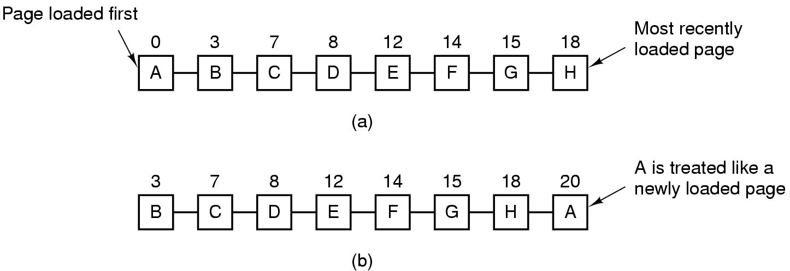
Second Chance Algorithm
Pages sorted in FIFO order by arrival time.
Examine R bit. If zero, evict. If one, put page at end of list and R is set to zero.
Specifically, imagine that all the pages in Figure have their R bits set. One by one, the operating system moves the pages to the end of the list, clearing the R bit each time it appends a page to the end of the list. Eventually, it comes back to page A, which now has its R bit cleared. At this point A is evicted.

Slide 23
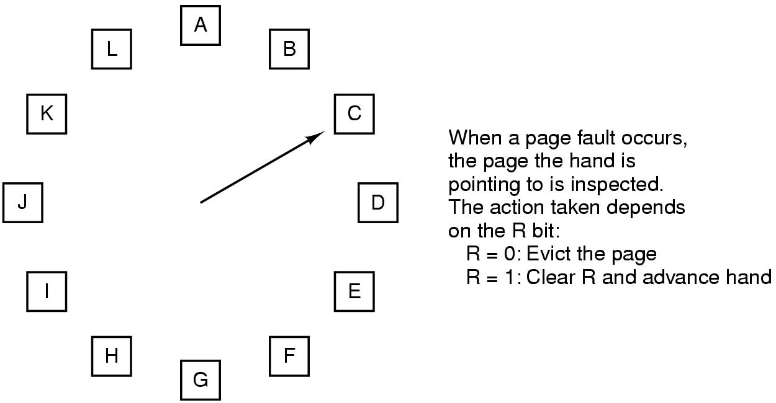
The Clock Page Replacement Algorithm
Although second chance is a reasonable algorithm, it is inefficient because it is constantly moving pages around on its list. A better approach is to keep all the page frames on a circular list in the form of a clock, as shown in the Figure. The hand points to the oldest page.
Tanenbaum, Modern Operating Systems 3 e, (c) 2008 Prentice-Hall, Inc. All rights reserved. 0-13-6006639

Slide 24
Least Recently Used (LRU)
A good approximation to the optimal algorithm is based on the observation that pages that have been heavily used in the last few instructions will probably be heavily used again soon. Conversely, pages that have not been used for ages will probably remain unused for a long time.
Could associate counters with each page and examine them but this is expensive
Tanenbaum, Modern Operating Systems 3 e, (c) 2008 Prentice-Hall, Inc. All rights reserved. 0-13-6006639

Slide 25
LRU- in Hardware
Associate counter with each page.
  At each reference increment counter.
  Evict page with lowest counter
Tanenbaum, Modern Operating Systems 3 e, (c) 2008 Prentice-Hall, Inc. All rights reserved. 0-13-6006639

Slide 26
LRU-software
Few, if any, machines have the required hardware. Instead, a solution that can be implemented in software is needed.
One possibility is called the NFU (Not Frequently Used) algorithm. It requires a software counter associated with each page, initially zero. At each clock interrupt, the operating system scans all the pages in memory. For each page, the R bit, which is 0 or 1, is added to the counter. The counters roughly keep track of how often each page has been referenced. When a page fault occurs, the page with the lowest counter is chosen for replacement.
The main problem with NFU is that it is like an elephant: it never forgets anything.
Tanenbaum, Modern Operating Systems 3 e, (c) 2008 Prentice-Hall, Inc. All rights reserved. 0-13-6006639

Slide 27
LRU-software
  A small modification to NFU makes it able to simulate LRU quite well. The modification has two parts. First, the counters are each shifted right 1 bit before the R bit is added in. Second, the R bit is added to the leftmost rather than the rightmost bit.
  “aging” algorithm
  On page fault, evict page with lowest counter
  Size of the counter determines the history
Tanenbaum, Modern Operating Systems 3 e, (c) 2008 Prentice-Hall, Inc. All rights reserved. 0-13-6006639

Slide 28
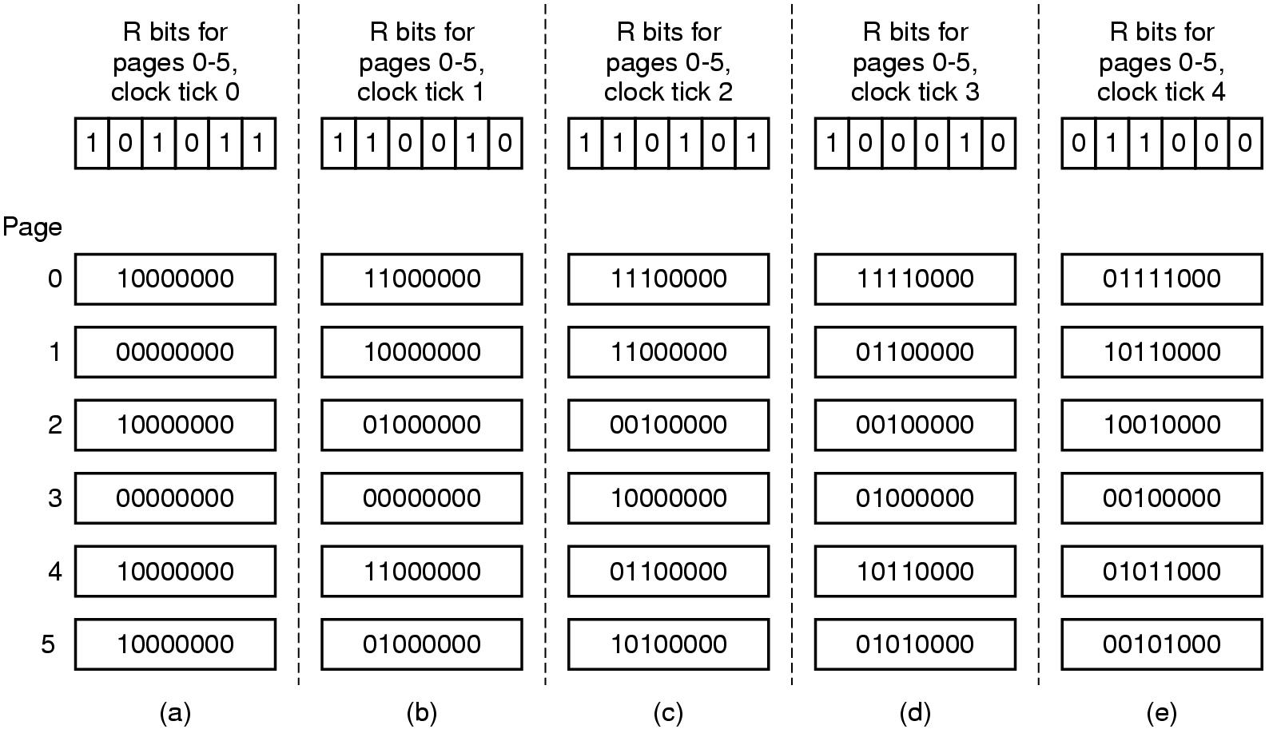
LRU in Software
Tanenbaum, Modern Operating Systems 3 e, (c) 2008 Prentice-Hall, Inc. All rights reserved. 0-13-6006639

Slide 29
Working Set Model
In the purest form of paging, processes are started up with none of their pages in memory. As soon as the CPU tries to fetch the first instruction, it gets a page fault, causing the operating system to bring in the page containing the first instruction. After a while, the process has most of the pages it needs and settles down to run with relatively few page faults. This strategy is called demand paging because pages are loaded only on demand, not in advance.
The set of pages that a process is currently using is its working set
Try to make sure that working set is in memory before letting process run (working set model or pre-paging)
Thrashing-If memory is too small to hold the entire working set, the process will cause many page faults and run slowly.
Tanenbaum, Modern Operating Systems 3 e, (c) 2008 Prentice-Hall, Inc. All rights reserved. 0-13-6006639

Slide 30
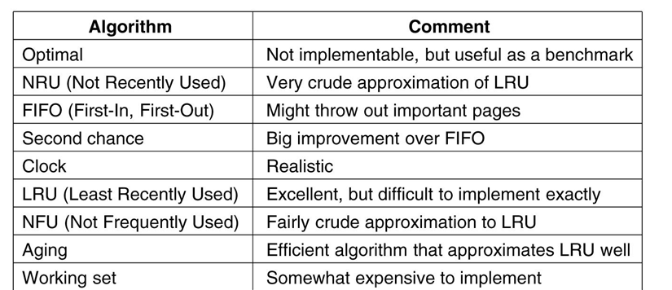
Summary of Page Replacement Algorithms
Tanenbaum, Modern Operating Systems 3 e, (c) 2008 Prentice-Hall, Inc. All rights reserved. 0-13-6006639

